Slide 1

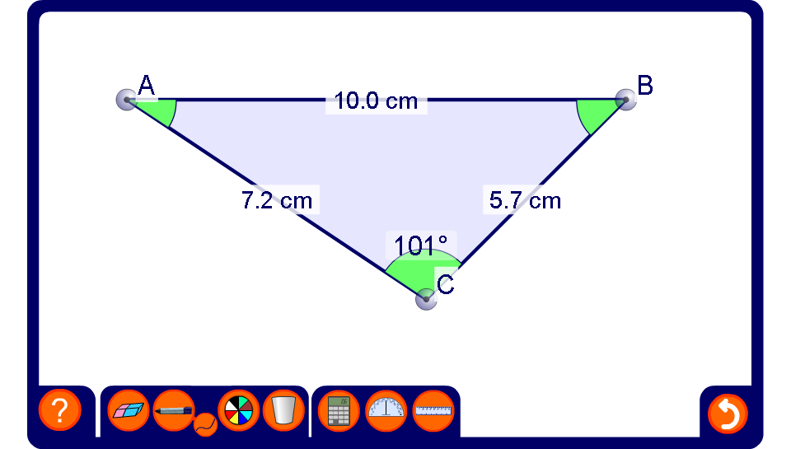


Using the sine rule to find side lengths
Notes:
Be aware that the lengths of the sides and the angles have been rounded. This means that, for example, the three angles in the triangle may not add up to exactly 180°.
Reveal an angle and the side opposite it. Reveal one more angle and ask pupils to find the side opposite it by using the sine rule.
Generate a new example by modifying the shape of the triangle.

